Slide 1
Systems Concepts & the Information Systems Environment
Introduction & Overview
Chapter 01

Slide 2
Objectives
By the end of this chapter, you should know –
The concept and primary characteristics of a system.
The importance of systems concept for developing information systems.
How various elements work together to interface with the end user.
Different types of system models and their features.
Different types of information systems and their features.

Slide 3
Introduction
By having crystal clarity of system relevant concepts one can –
Understand the relationships among subsystems and their contribution to meet a common goal.
Identify a suitable system model basing on the characteristics of a context.
Design a framework by analyzing and visualizing the organizational and environmental factors that operate on a system.
Assess anticipated and unanticipated consequences on various components of a system for different computer based applications.

Slide 4
The Systems Concept
Scholars from different disciplines have emphasized to have a close look at all parts of a system using and unifying approach rather than focusing on only one component or fragments.
System analysis and design for information system is founded upon General Systems Theory which is concerned with “Developing a systematic, theoretical framework upon which to make decisions. It discourages thinking in a vacuum and encourages consideration of all the activities of the organization and its external environment. It has also emphasized that organizations must be viewed as total systems.”

Slide 5
The Systems Concept
The idea of systems has become most practical and necessary in conceptualizing the inter-relationships and integration of operations, specially when using computers.
A system is a way of thinking about organizations and their problems.
A system also involves a set of techniques that helps in solving problems.
A system maybe considered as processor that takes information as input and provides decisions as output for an organization.
Input (Information)
Processor
Output (Decisions)
System

Slide 6
What is System?
The word system is derived from the Greek word “systema” which means an organized relationship among the functioning units/components.
A system exists because it is designed to achieve one/more objectives.
Examples of systems include – telephone system, educational system, transportation system, accounting system etc.
But if we carefully analyze these systems we can find that there are some features common to all the systems.

Slide 7
What is System?
The three basic implications of a system are –
A system must be designed to achieve a predetermined objective.
Inter-relationships and interdependence must exist among the components.
The objectives of the organization as a whole have a higher priority than the objectives of its subsystems.
The word “component” usually refers to functioning units of a system that might be –
Physical parts (e.g. engines, wheels of a car)
Managerial steps (e.g. planning, organizing)
Subsystem in a multilevel structure
The components may be simple/complex, basic/advanced.
Each component is part of the total system and must do its share of work for the system to achieve the intended goal.

Slide 8
Definition: System
There are more than a hundred definitions of the word system, but most seem to have a common thread that suggests that -
A system is an orderly grouping of interdependent components linked together according to a plan to achieve a specific objective.

Slide 9
Characteristics of a System
Some basic characteristics are present in all systems –
Organization
Interaction
Interdependence
Integration
Central Objective

Slide 10
Organization
Organization implies structure and order.
It is the arrangement of components that helps to achieve objectives.
For example,
In business system, the hierarchical relationship starting with the president on top and leading downward to workers represents the organization structure which defines the authority structure or chain of command where president, vice president, workers etc. are components.
In computer system, the input device, processor, output device, storage unit etc. components are linked together to work as a whole system for producing information.

Slide 11
Interaction
Interaction refers to the manner in which each component functions with other components of the system.
The inter-relationship between the components enables a system to perform its functions successfully.
For example,
Purchasing must interact with production, advertising with sales etc.
In computer system, the CPU must interact with the input device to solve a problem. In turn, the main memory holds programs and data that the ALU uses for computation.

Slide 12
Interdependence
Interdependence means that parts of the organization or system depend on one another.
They are coordinated and linked together according to a plan.
One subsystem depends on the input of another subsystem for proper functioning and cannot function in isolation.
For example,
The personnel subsystem (higher level) is dependent on health and safety subsystem (middle level) which in turn is dependent on a lower level subsystem.

Slide 13
Integration
Integration refers to the holism/synthesis of the system.
It is concerned with how a system is tied together in order to achieve the central objective of the organization.
It means that part of the system work together within the system even though each part performs a unique function
Successful integration typically produces a synergistic effect and greater total impact than if each component works individually.
Synergistic Effect: relating to the interaction or cooperation of two or more organizations, substances, or other agents to produce a combined effect greater than the sum of their separate effects.

Slide 14
Central Objective
Central Objective refers to the common goal/aim of the system.
The central objective maybe real or stated.
It is common for an organization to state one objective and operate to achieve another which might not be identical but is preferable to be similar.
Without a common goal the components will start moving in different direction and hence lack of coordination will occur among the components.

Slide 15
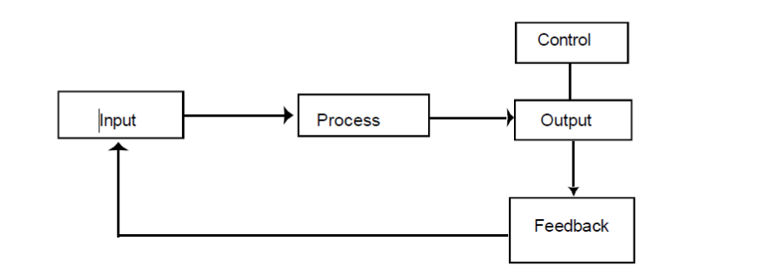
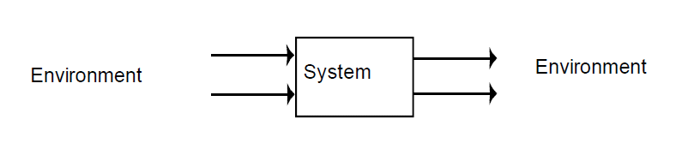
Elements of a System
System analysis operate in a dynamic environment. The environment may be a business application or a computer system or any other system. The following key elements are present in all systems –
Outputs and Inputs
Processor(s)
Control
Feedback
Environment
Boundaries and Interface

Slide 16
Outputs and Inputs
Output is the outcome of processing.
A major objective of a system is to produce an output that has value to its user, that is the output must meet the expectations of the intended user.
Output can be goods, services or information.
Inputs are the elements that enter the system for processing.
Input can be material, information or human resources.
It is important to understand that determining the output is a first step in specifying the nature, amount and regularity of the input needed to operate a system.
In system analysis, the first concern is to determine the user’s requirements of a proposed system.

Slide 17
Processor(s)
Processor is the element of a system that involves the actual transformation of input into output.
It is the operational component of a system.
Processors may modify the input partially or totally, depending on the specifications of the output.
This mean as the output specifications change, so does the processing.
In some cases, input is also modified to enable the processor to handle the transformation.

Slide 18
Control
Control guides the system.
It is the decision making subsystem that controls the pattern of activities governing input, processing and output.
In system analysis, knowing the attitude of the individual who controls the area for which can make a difference between the success and failure of the system objective.
For example,
In a organizational context, management as a decision making body controls the inflow, handling and outflow of activities that affect the welfare of the business.

Slide 19
Feedback
Feedback measures output against a standard in some form of cybernetic procedure that includes communication and control.
Output information is fed back to the input and after the output is compared against performance standards, changes can result in the input or processing and consequently, the output.
Positive feedback reinforces the performance of the system which is routine in nature.
Negative feedback generally provides the controller with information for action and thus is informational in nature.
Another type of feedback is concerned after the system is implemented regarding user requirements.

Slide 20
Environment
Environment is the “suprasystem” within which an organization operates.
It is the source of external elements that has effect on the system.
It often determines how a system must function.
For example,
An organization’s environment consisting of vendors, competitors and others may provide constraints and consequently influence that actual performance of the system.

Slide 21
Boundaries and Interface
Boundaries are the limits that identify its components, processes and inter-relationships when it interfaces with another system.
A system should be defined by its boundaries which determines its sphere of influence and control.
The interconnections and interactions among the subsystems are termed as interfaces. In fact, each interface implies a communication path. Number of interfaces increase with number of subsystems.
For example,
An automated teller machine (ATM) generally does not accept deposits.
The online transaction and traditional transaction procedure differ in terms of interface and interaction.

Slide 22
Types of Systems
Systems have been classified in different ways. Common classifications are:
Physical and Abstract System
Open and Closed System
Deterministic and Probabilistic System
“Man-Made” System: Information Systems

Slide 23
Physical and Abstract Systems
Physical Systems are tangible entities that maybe static or dynamic in operation.
Static: the physical parts of the computer center are – offices, desks and chairs that facilitate operation of the computer. They can be seen and counted.
Dynamic: a programmed computer is a dynamic system. Data, programs, output and applications change as the user’s demands or the priority of the information requested changes.
Abstract Systems are conceptual/nonphysical entities. They maybe straightforward as formulas of relationships among sets of variables or models. For example, graphical model of a stock market behavior.

Slide 24
Systems Models
Model is referred to as the abstract conceptualization of physical situations.
A model is a representation of a real or a planned system.
The use of models makes it easier for the analyst to visualize relationships in the system under study.
The analyst begins by creating a model of the reality (facts, relationships, procedures etc.) with which the system is concerned.
For example, a telephone switching system is made up of subscribers, telephone handsets, dialing, conference calls etc. The analyst begins by modeling this reality before considering the functions that the system is to perform.
The major models are: schematic, flow, static and dynamic system models.

Slide 25
Systems Models
Schematic Models
A two-dimensional chart depicting system elements and their linkages using abstract, graphical symbols to represent the material and information flow of a system. For example, A concept map graphically represents the relationships between concepts or ideas and helps in organizing and structuring the information.
Flow System Models
It shows the orderly and logical flow chart of the material, energy and information that hold the system together. For example, PERT chart (Program Evaluation and Review Technique) is used to manipulate specific values to determine the probability of completion of various tasks within a time period and interpret the relationships. It has parallel networks of individual tasks, focuses on inter-task relationships and used is small parts of a project for its complexity.

Slide 26
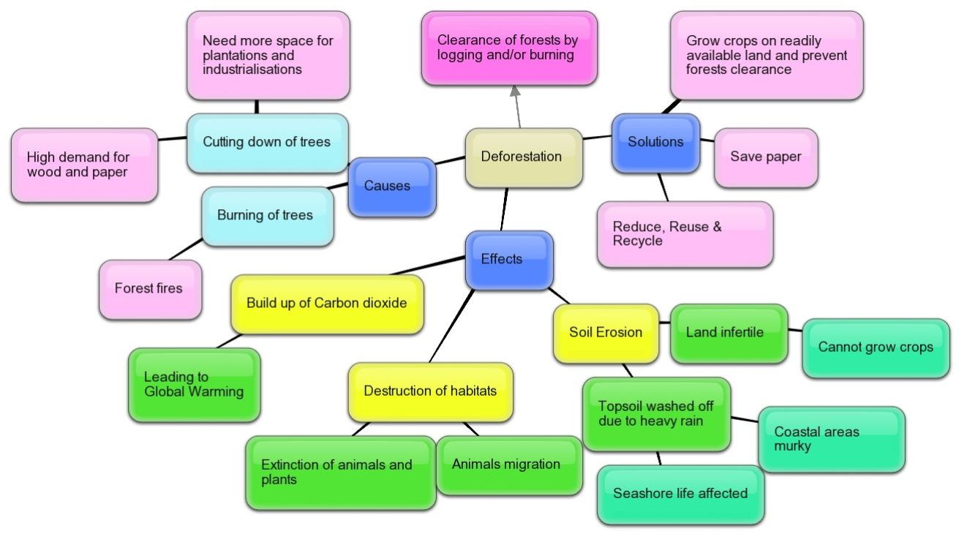
Systems Models
Schematic Models: Concept Map

Slide 27
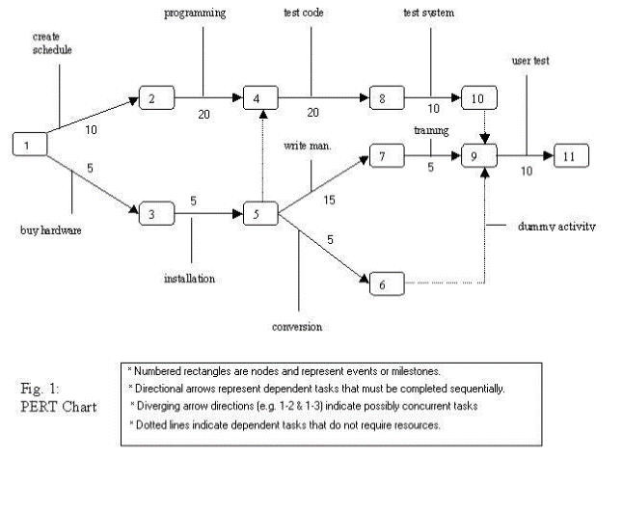
Systems Models
Flow System Models: PERT Chart

Slide 28
Systems Models
Static System Models
This type of model exhibits one pair of relationships such as activity-time or cost-quantity using linear representations. For example, the Gantt chart gives a static picture of an activity-time relationship which uses bar charts that show project activities, milestones and the amount of time they will take. Gantt chart is straightforward and are not generally used for projects that require continuous changes and mainly focuses on time required to complete a task.
Dynamic System Models
It depicts an ongoing constantly changing system where different types of external and internal factors affects the behavior of the system. For example, business organizations are dynamic systems. The behavior of processing, input/output etc. may change continuously by the factors such as competitors, government, economic indicators, informational feedback and so on.

Slide 29
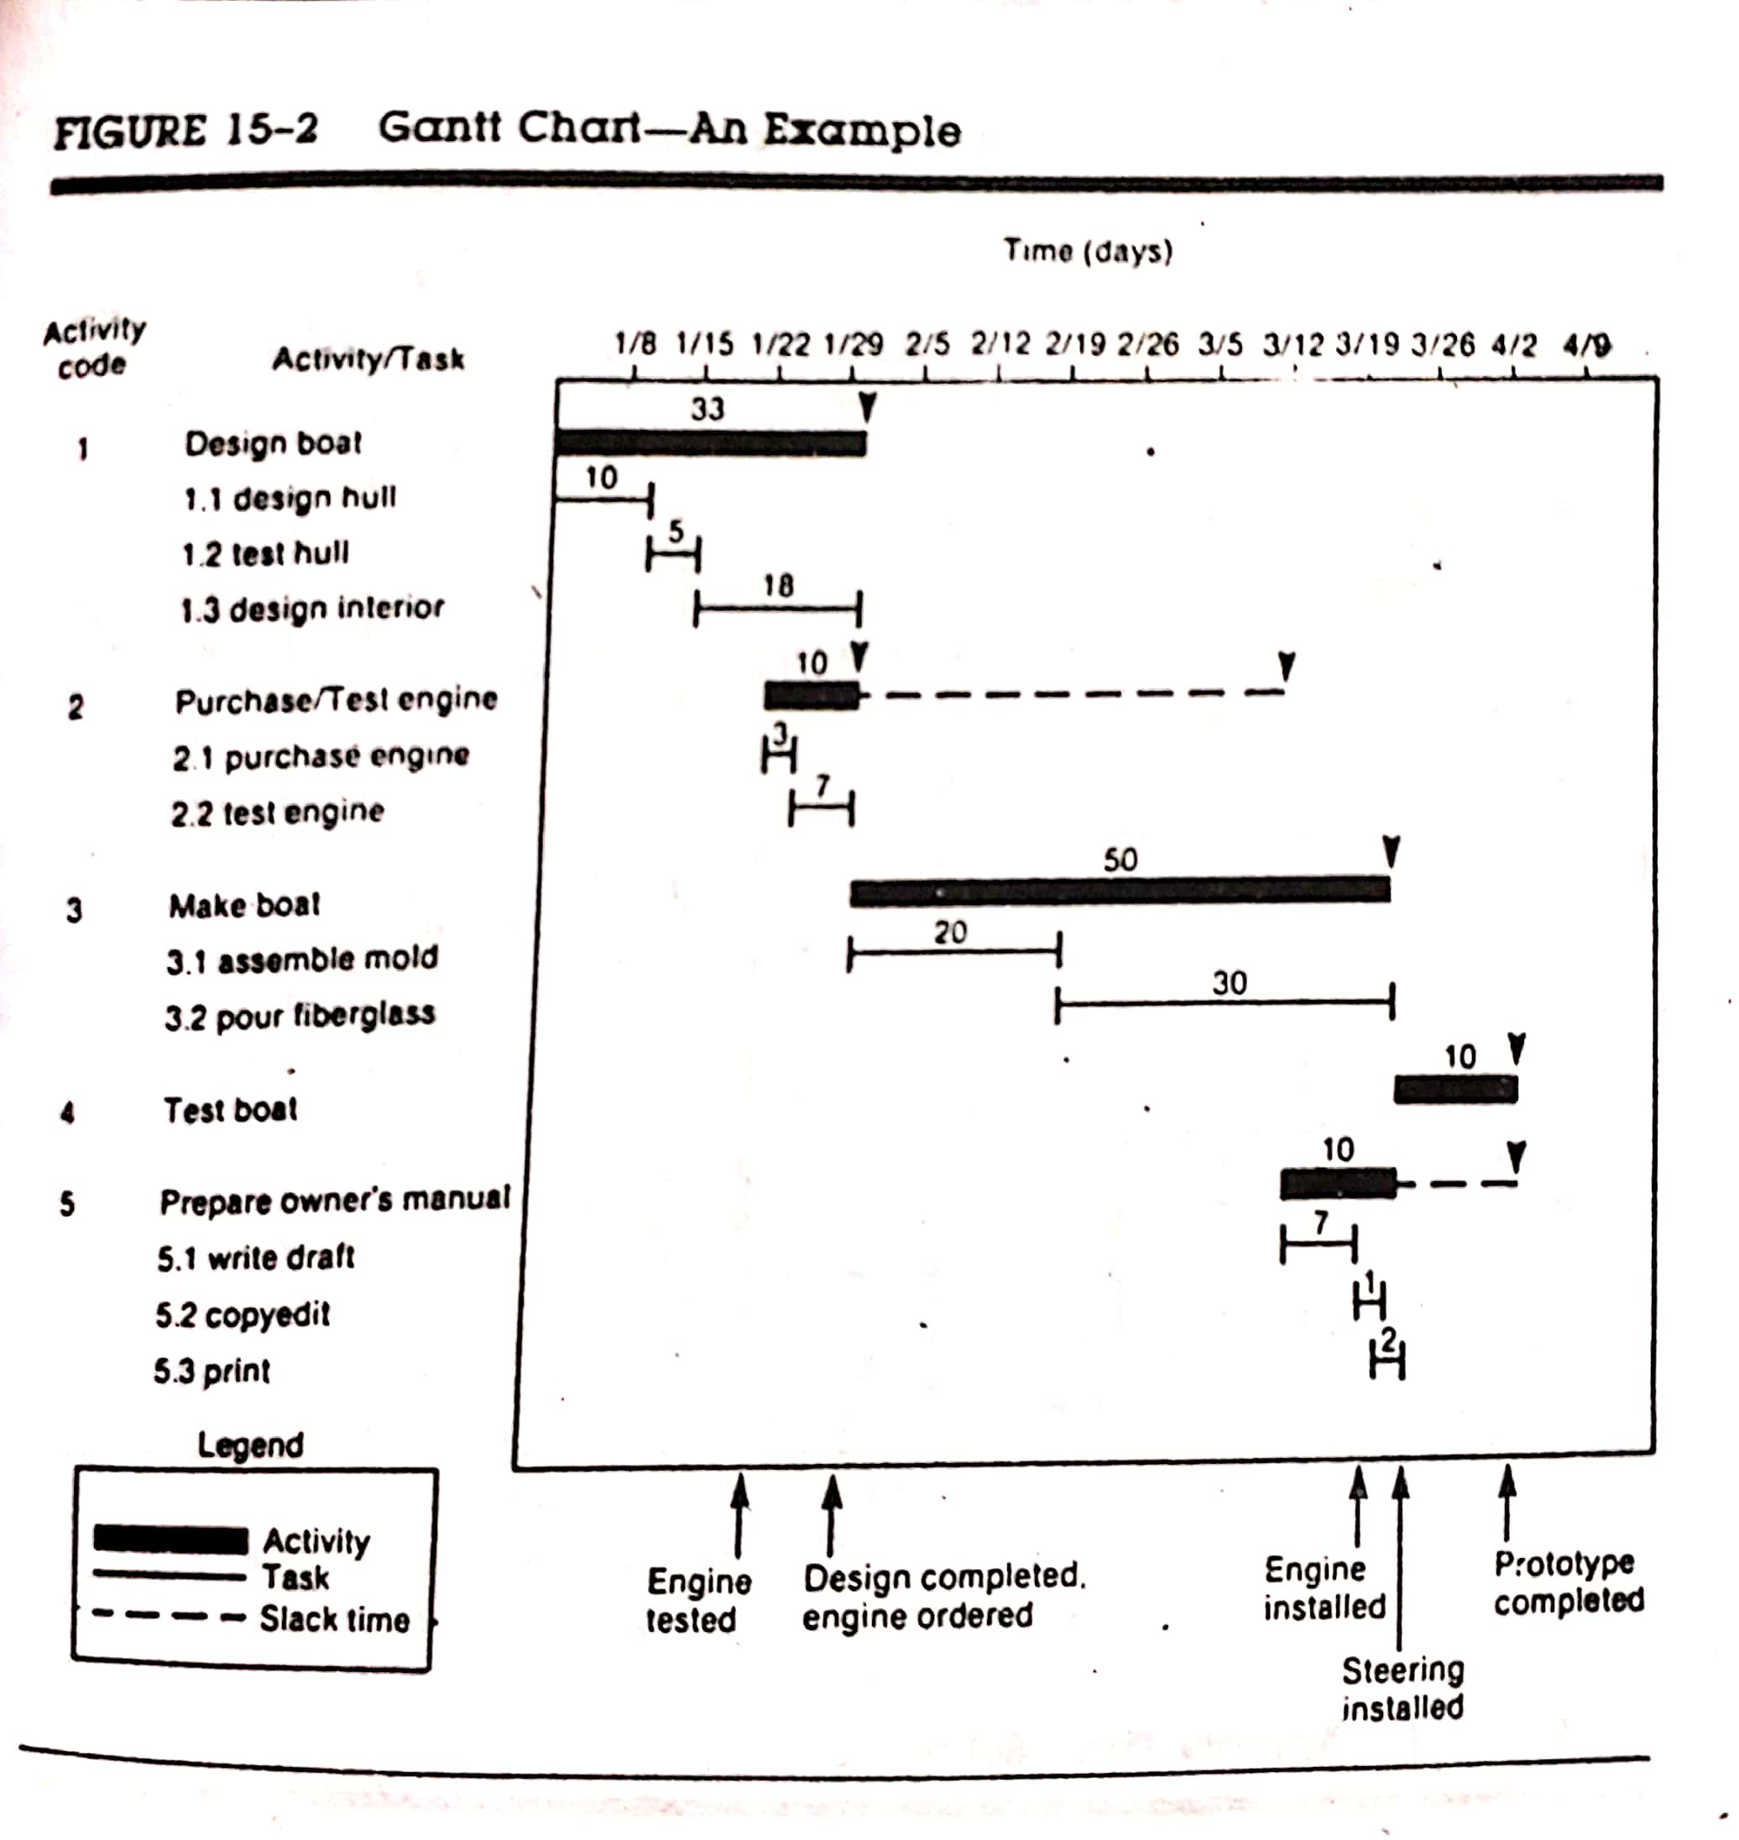
Systems Models
Static System Models: Gantt Chart

Slide 30
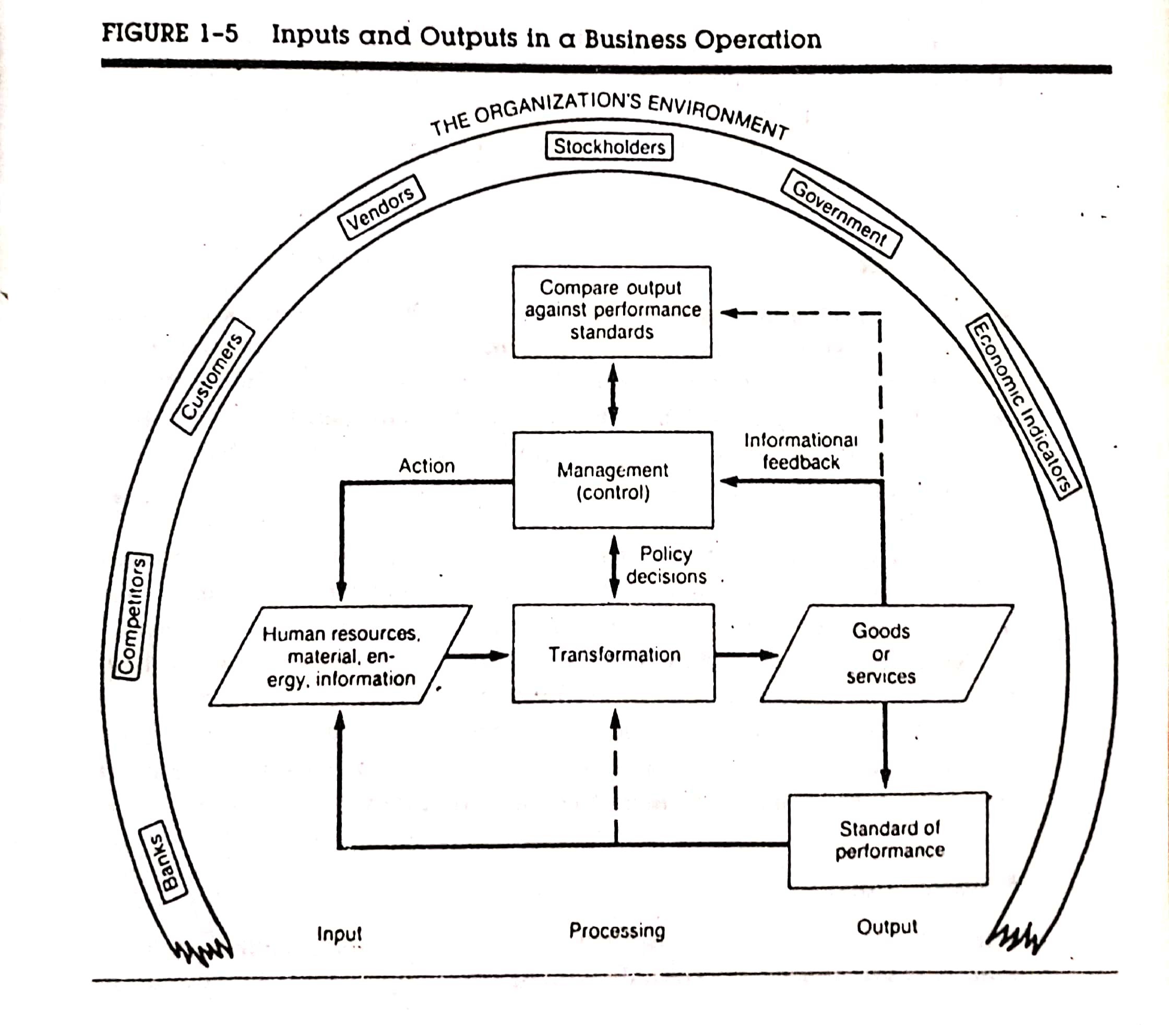
Systems Models
Dynamic System Models: Business Organization

Slide 31
Open and Closed Systems
Open Systems are independent and have many interfaces with its environment. It receives inputs from and delivers output to the outside. It permits interaction across its boundary and adapts to the changing demands of the user and environment. For example, weather forecasting system.
Closed Systems are not dependent and isolated from environmental influences. Such systems are rare. Closed systems can hamper growth since the flow of information stays within the system and has no chance to interact with or build on knowledge from the outer environment. For example, production line system in a factory.

Slide 32
Deterministic and Probabilistic Systems
Deterministic Systems operate in a predictable manner and the interaction between system components is known with certainty. Stepwise execution is possible and output is sure. For example, an automated teller machine (ATM).
Probabilistic Systems show uncertain behavior. The exact output is not known but can be predicted. There might exist some degree of error. For example, weather forecasting system.

Slide 33
“Man-Made” System: Information Systems
An Information System maybe defined as a set of devices, procedures and operating systems designed around user-based criteria to produce information and communicate it to the user for planning, control and performance.
It is referred to as “Man-Made” system because the concern of user requirements has the foremost priority.
It is the basis for interaction between the user and the analyst and provides instructions, commands and feedback to help in decision making.
In system analysis, it is important to keep in mind that considering an alternative system means improving one or more of these user-based criteria.

Slide 34
“Man-Made” System: Information Systems
The major information systems are classified as follows –
Formal Information Systems
Informal Information Systems
Computer-Based Information Systems

Slide 35
Formal Information Systems
A Formal Information System is based on the organization represented by the organization chart which is a map of positions and their authority relationships.
It is concerned with the pattern of authority, communication and workflow.
Information is formally disseminated in instructions, memos or reports from top management to the intended user in the organization.
Policies from top management are generalizations that are translated into rules and transmitted to lower level management for implementation.
The output represents employee performance.
For example, education management system.

Slide 36
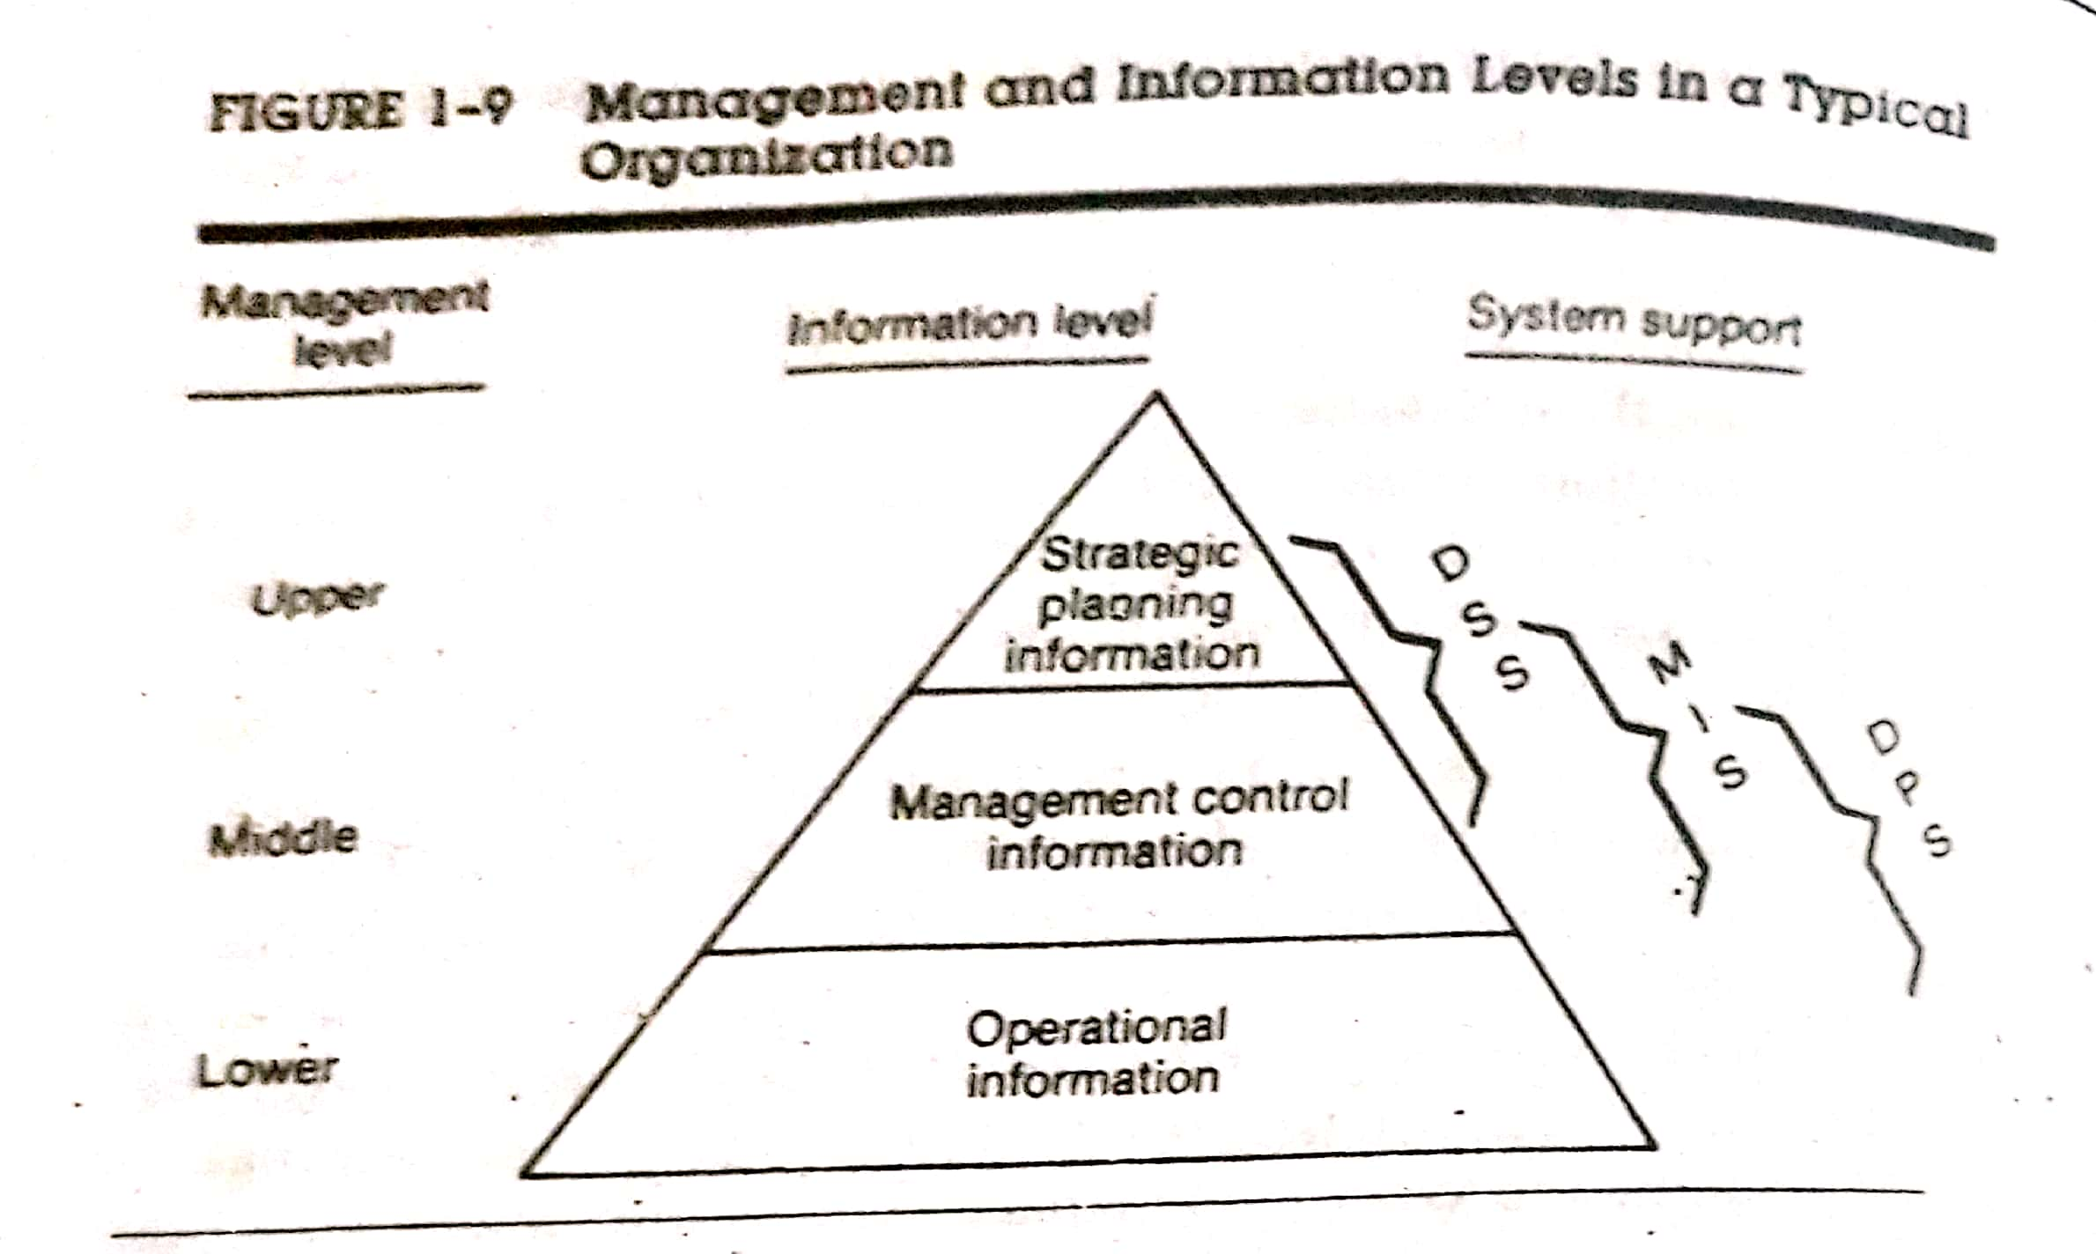
Formal Information Systems: Categories of Information
There are three categories of information related to formal information system –
Strategic Information – Top Level/Higher Level
Managerial Information – Middle Level
Operational Information – Lower Level

Slide 37
Formal Information Systems: Strategic Information
Strategic Information
Comprises of accurate, relevant, complete, concise and timely information of the organization
Direct interest to upper management
Relates to long range planning policies
For example, population growth, trends in financial investment, human resources changes etc.
Aided by Decision Support System (DSS)

Slide 38
Formal Information Systems: Strategic Information
Managerial Information
Comprises of summarized information from a variety of sources
Direct interest to middle management
Relates to intermediate range planning (e.g. department heads for implementation and control)
For example, sales analysis, cash flow projections, financial statements etc. (months rather than years)
Aided by Management Information System (MIS)

Slide 39
Formal Information Systems: Strategic Information
Operational Information
Comprises of detailed internal information of particular department
Direct interest to lower management
Relates to short range planning (e.g. daily information used to operate departments and enforce day to day rules of the business)
For example, daily employee absence sheets, overdue purchase orders, current stocks available for sale etc.
Aided by Data Processing System (DPS)

Slide 40
Informal Information Systems
An Informal Information System tends to restrict the communication flow among employees to ensure performance and thus an Informal Information System develops.
It is an employee based system designed to meet personnel and vocational needs and to help solve work related problems.
It also funnels information upward/downward through indirect channels.
It is a useful system because it works within the framework of the business and its stated policies.
Employee cooperation and participation helps inner workings and knowledge sharing which is useful during exploratory phase of analysis.
For example, Forum System

Slide 41
Computer-Based Information Systems
A Computer-Based Information System relies on the computer for handling business applications.
The computer is a required source of information and system analysis relies heavily on computers for problem solving.
The analyst must be familiar with computer technology and have experience in handling people in organizational context.
Management Information System (MIS), Decision Support System (DSS) and Data Processing System (DPS) can perform efficiently using various computerized techniques.

Slide 42
Computer-Based Information Systems: DPS/TPS
Functions
Processes a set of inputs produces a defined set of outputs.
Updates history files or day to day transactions.
Prepares summarized, processed transaction and generates detailed transaction reports.
Applications
Accountancy, invoicing, stock control, attendance record, data entry etc.
Users
Lower level management employees
Benefits
Stores all transactions.
Helps to trace out the problem.
Gives current status of all the organizational entities.

Slide 43
Computer-Based Information Systems: MIS
Functions
Converts data from internal and external sources from DPS/TPS into information.
Communicates in an appropriate form to managers at different levels of an organization.
Produce reports for managers interested in historic trends on a weekly, monthly and yearly basis.
Applications
A supermarket will provide reports that show the sales figures for each department each day for a week, with weekly totals, monthly totals, comparisons with last month etc.
Users
Middle level management employees
Benefits
Helps in short term planning.
Helps in analyzing information using various statistical model and mathematical techniques.

Slide 44
Computer-Based Information Systems: DSS
Functions
Provides information and models in a form to help tactical and strategic decision-making.
Enables a manager to explore a range of alternatives under a variety of conditions.
Tends to be a combination of summary information gathered from lower level DPS and MIS and also includes significant information from external data sources.
Applications
A manager may wish to know the effects on profits if sales increase and costs decrease.
Users
Upper level management employees.
Benefits
Helps in future long term policy planning.
Useful when making ad-hoc, one-off decisions.

Slide 45
THANK YOU

